Slide 1

Desire to be proud of what we do
SOFTWARE
CRAFTSMANSHIP
Sustenance model
Bharat
MANE

Slide 2
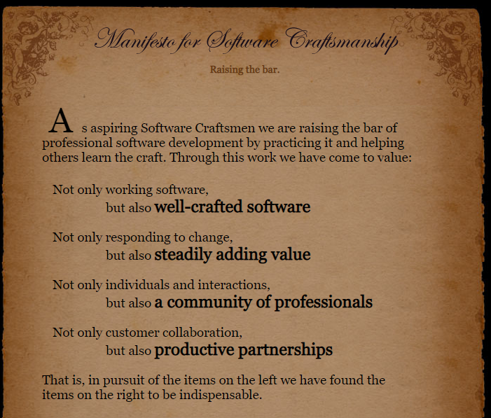
Manifesto
for Software Craftsmanship
https://manifesto.softwarecraftsmanship.org/
Bharat
MANE

Slide 3
Motivation
The origins of software craftsmanship came from the Agile software development movement which aimed to reform software project management in the 1990s.
In December of 2008, a summit was held in Chicago that resulted in the drafting of the Software Craftsmanship Manifesto:

Slide 4
The Problem definition
In spite of close to 2 decades , the adoption and sustenance is still not as much as it should be. A very small percentage of organization practice the software craftsmanship to it’s core.
Objective of this research is to propose the model that would help adopt and most importantly sustain software craftsmanship
The model that covers four areas and 40+ practices that can be measured over 5 key process indicators
NOTE: At present this model is evolving and being piloted at Society Générale. There are few others who are also contributing to the evolution of this model

Slide 5
Four
areas
Tool mastery
Developer experience
Development Practices
People

Slide 6
Change
Lead Time
Deployment frequency
5 Key process
indicators
Change fail rate
Mean time to restore
Service availability

Slide 7
5 Key process
indicators
Reduced LEAD TIME by reducing wasteful activities, which, in turn, let us deploy more frequently.
Increased DEPLOYMENT FREQUENCY forces the teams to improve their practices and automation.
Better practices and automation leads to the improved CHANCE FAIL RATE and TIME TO RESTORE.
The improved Change Fail Rate and Time to Restore lead to an improved SERVICE AVAILABILITY

Slide 8
Forty+ practices
Development Practices | People | Tool Mastery | Developer Experience
Naming Conventions/Clean Code | Recruitment Evaluation | Development Environment (code editor, IDE) | Backing from PO & Senior Leadership on craft
API Naming Conventions | Growth Mindset | GIT or any other VCS | Trainings
Restfulness | Psychological safety | CI/CD Pipeline | access to information
Design Patterns | Re-usability | Tests are triggered automatically with metrics | onboarding process
Domain Definition (DDD) | Refuse complexity and over- engineering (YAGNI) | Code Quality SONAR | Administrative processes vs development time
Design Principles (SOLID, KISS, DRY, YAGNI, POLA) | Ownership Mindset | Code Security, Checkmarks | Softwares & Hardwares
Code Reviews | End-to-End value delivery | Deployment XLDeploy
Pair Programming | Cross functional teams | Infra as a code
Continuous Refactoring | The code is own by the community
TDD
Code Coverage
BDD
Business Involvement for BDD
Mutation Testing
Integration Testing
Logging
UX For developers
Microservices Design
Think of performance during design
Vulnerability

Slide 9

Development Practices
Design Principles
We apply best suited design and patterns, for example DDD with Hexagonal architecture only if relevant
We immediately start coding without taking design into consideration
We seldom apply design principles. When we do, it's an individual effort. It can result in design flaws that go unnoticed for a long time
We usually apply design principles. However still it's an individual effort and is not always collectively discussed
We often apply design principles. This time it's the result of a collective effort and is systematically discussed
Architecture is constantly reviewed and discussed collectively. Spotted design issues are addressed as soon as possible
HINT
1. Importance of Design
2. Design is discussed
3. Review frequency

Slide 10
https://github.com/bharatmane/public-presentaions

